Slide 1

RISK AND RESILIENCE BOOTCAMP
1

Slide 2


Slide 3
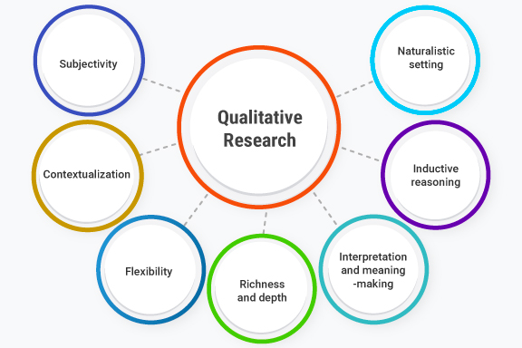
Qualitative Assessment
This module expores the topic of qualitative assessment of risk through:
SME best judgments and opinions
Structured evaluations
Descriptive scales

Slide 4
Qualitative analysis
A systematic method of inquiry that focuses characterized by
Identifying, interpreting, and explaining the characteristics, meanings, patterns, and relationships present in non-numerical data
Relying on conceptual categorization, thematic interpretation, or structural examination rather than numerical measurement
Generating rich, contextualized understanding of phenomena by analyzing textual, visual, auditory, or observational data through iterative, transparent, and methodologically justified procedures
Qualitative analysis is a discipline-neutral methodology

Slide 5
Qualitative analysis
Characteristics
The nature of the data it operates on is
Non-quantified: For example: text, images, behaviors, symbols, speech
Complex and context-dependent
Open to multiple levels of meaning : For example literal, subjective or cultural
An analytical process involving
Systematic coding or classification of data into meaningful categories
Identification of patterns, themes, or constructs
Interpretive reasoning grounded in the data
Iterative refinement of categories and interpretations
Explicit methodological transparency to ensure rigor and credibility.

Slide 6
Qualitative Risk Assessment
Uses non-numerical scales to rate:
Likelihood of a risk occurring
Impact the risk would have
Overall risk priority
It relies on information gathered from
Subject matter expertise
Organizational experience
Interviews and workshops
Trend data
Stakeholder perceptions
While not mathematically precise, qualitative assessment accelerates decision making and supports triage of risks for deeper analysis

Slide 7
Ordinal data
A type of measurement scale
Used in qualitative research where data are categorized and ranked
But the distances between the ranks are not meaningful
Key characteristics
Categories are ordered (lowest to highest, least to most, etc.)
No fixed or equal intervals between categories
No meaningful zero point
Labels are often words, not numbers, though numbers may be used for coding

Slide 8
Ordinal data
Ordinal scales are useful when researchers want to
Capture attitudes, preferences, or perceptions
Measure levels of a qualitative attribute
Convert open-ended or textual information into analyzable ranked categories
Combine qualitative insight with basic quantitative analysis
Ordinal scales bridge the gap between purely qualitative data (e.g., interview text) and measurable patterns

Slide 9
Ordinal data
Appropriate statistical treatment
Appropriate methods
Median, mode
Percentiles
Non-parametric tests (Mann–Whitney U, Kruskal–Wallis)
Rank correlation (Spearman’s rho, Kendall’s tau)
Not appropriate
Mean
Standard deviation
Parametric tests based on equal intervals

Slide 10
Ordinal data
Advantages of ordinal scales
Easy for respondents to understand
Provides nuanced insight beyond simple categories
Allows ordering of qualitative traits
Compatible with both qualitative interpretation and quantitative coding
Limitations of ordinal scales
Cannot interpret the magnitude of differences
Statistical options are more limited
Results may be sensitive to wording or cultural interpretation
Ambiguity if categories are unevenly spaced psychologically

Slide 11
Qualitative analysis
Reasons to use qualitative assessment
Fast and cost-effective
No need for complex models or specialized data
Works well with incomplete data
Ideal when assessing emerging risks or new projects
Engages stakeholders
Brings in expert knowledge and perspectives that numbers alone cannot reveal
Prioritization support
Gives organizations a simple, consistent way to rank risks.

Slide 12
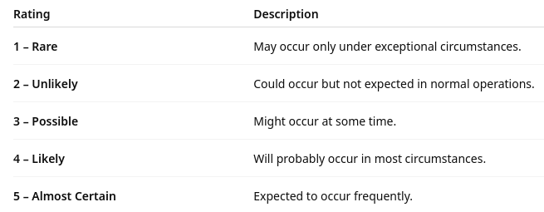
Common Qualitative Scales
Likelihood Scale Example

Slide 13
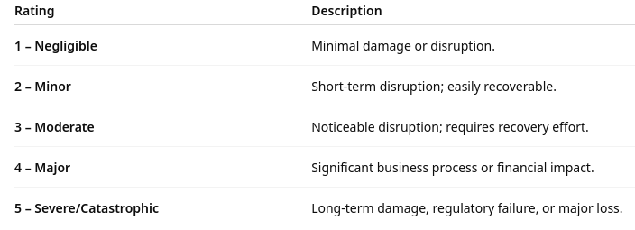
Common Qualitative Scales
Impact Scale Example

Slide 14
Expert Opinion
Experts often have deep practical knowledge but may lack precise quantifiable data
SME’s structured insights help
Identify risks not visible in metrics
Validate assumptions
Provide scenario-based insights (“What would happen if…?”)
Add context around process weaknesses, operational realities, or threat behaviors

Slide 15
Expert Opinion
Methods for gathering expert opinion
Interviews: One-on-one sessions with SMEs
Workshops: Facilitated group discussions
Delphi Technique: Anonymous rounds of feedback until consensus is reached
SME Scoring: Experts independently score likelihood and impact
Differences in opinion can be due to
Different experiences with the similar process or risk or events
Different roles and perspectives taken by their professions
Access to different data across industries and organizations
Different methods of analysis and interpretation of the same data
Assigning different levels of significance to different parts of the data

Slide 16
Surveys and Questionnaires
Gather insights across broader groups
Both within the organization and externally (user opinions for example)
Particularly useful in large or distributed teams
Provide a scalable way to capture perceptions of risk, operational concerns, and confidence in existing controls
However, survey often reflect perceived risk rather than actual risk
Allow for a larger data set of opinions
Can be used to identify trends and clusters of opinions and analyses
Allow for factor analysis
For example: perception of the risk posed by AI tools by different operational groups
For example: correlation between two different risks – seem by experts as being connected

Slide 17
Problems With Surveys
Typical issues that can skew survey results
Low response rates can make findings unrepresentative
Self-selection bias: only highly concerned or highly disengaged people respond
Ambiguous wording leads to inconsistent interpretations
For example: “system downtime” may mean hours to some, minutes to others
Leading or risk-loaded questions can make the replies unreliable
Reliance on ordinal scales may reduce complex issues to oversimplified answers
Survey results reflect beliefs, not technical evidence
Skews data to show perceived risk and not real risk
Lack of context may cause respondents to guess rather than answer confidently
People often answer carelessly without thinking about their answer
For example: They just want to be done with the chore of answering the survey
For example: nay saying and yea saying behaviors

Slide 18
Benefits of Surveys
Surveys can provide strong value by
Identifying trends and perception shifts over time
Comparing confidence levels across teams or departments
Highlighting areas where technical teams may need to communicate better
Building a heat map of perceived risk
Supporting prioritization for deeper, evidence-based assessments
Survey blind spots
Surveys should be based on prior interviews or data analysis
This identifies the questions that should be asked
Should include a section asking for feedback on potential blind spots
“Is there anything that in your opinion should have been asked about in this survey?”

Slide 19
Historical Trends
Qualitative assessment can be enriched by identifying historical patterns in data from
Incident logs
Ticketing system data (e.g., ServiceNow, Jira)
Security event trends
Audit findings
Vendor performance issues
Previous project retrospectives
Root cause analyses
Historical trends provide:
Evidence for likelihood estimation
Context for impact assessment
Understanding of seasonal or recurring risks
Identification of chronic weak controls

Slide 20
Cognitive biases
The use of historical and comparative data can identify cognitive biases that can occur in interviews and group data collection
Anchoring bias
The tendency to rely too heavily on the first piece of information presented (the “anchor”)
For example: if the interviewer mentions “low likelihood events,” the SME may unintentionally frame all responses around low likelihood even when high-impact events exist
Impact
Skews likelihood ratings
Narrows thinking
Mitigation
Avoid suggesting ranges before SME answers
Ask open-ended questions first

Slide 21
Cognitive biases
Availability heuristic
Judging risks based on how easily examples come to mind, often driven by recent or memorable events
For example: an SME recently experienced a security incident and may overestimate its frequency or importance
Impact
Over-weighting recent or dramatic events
Under-weighting long-standing but less visible risks
Mitigation
Ask SMEs to reference data, not just memory
Use structured prompts: “Are there less visible risks we might be missing?”

Slide 22
Cognitive biases
Confirmation bias
Seeking or interpreting information that confirms existing beliefs or opinions
For example: if an SME believes a control is effective, they may downplay incidents or evidence suggesting weaknesses
Impact
Inflated confidence in existing controls
Rejection of contradictory information
Mitigation
Ask on-purpose disconfirming questions:
“Can you think of situations where this control might fail?”

Slide 23
Cognitive biases
Overconfidence bias
Overestimating one’s knowledge, memory, or accuracy of judgment
For example: an SME claims “that process never fails” without data to support the statement
Impact
Underestimating likelihood
False sense of control maturity
Mitigation
Encourage approximate ranges rather than absolutes
Ask for examples, evidence, or exceptions

Slide 24
Cognitive biases
Status quo bias
A preference for the current state of affairs and reluctance to acknowledge problems
For example: an SME may deny risks in a long-standing process simply because “it’s always been done this way”
Impact
Blind spots in legacy processes
Failure to recognize systemic risks
Mitigation
Ask what changes or failures would look like
Use scenario-based probing

Slide 25
Cognitive biases
Social desirability bias
Respondents tend to give answers they believe will be viewed favorably
For example: an SME may underreport known process weaknesses out of fear of blame or reputational impact
Impact
Hidden failure points
Overstated maturity
Mitigation
Emphasize confidentiality and non-attribution
Use neutral, non-judgmental question wording

Slide 26
Cognitive biases
Normalcy bias
Assuming future operations will resemble past operations and underestimating rare but high-impact risks
For example: an SME dismisses disaster scenarios because “we’ve never had that happen”
Impact
Underestimation of catastrophic but plausible risks
Mitigation
Use structured hypothetical questions (“What if…?”)
Provide external examples from similar organizations

Slide 27
Cognitive biases
Group think
The desire for group harmony leads participants to avoid expressing dissenting views
For example: in a group risk workshop, one dominant SME sets the tone and others follow.
Impact
Suppressed minority opinions
Loss of nuanced or conflicting evidence
Mitigation
Gather individual ratings first, then discuss
Use anonymous voting tools

Slide 28
Cognitive biases
Recency bias
Recent events are judged as more significant than earlier events
For example: a minor incident last week overshadows more important but older risks
Impact
Inflated ratings for recent issues
Neglect of long-term systemic risks
Mitigation
Ask SMEs to think across multiple timeframes (3 months, 1 year, 3 years)

Slide 29
Qualitative Assessment Process
Typical process
Step 1: collect inputs
Interview SMEs about operational risks
Review historical incident reports
Conduct surveys with frontline staff
Step 2: use a standard scale
Rate each risk on a 1–5 scale for likelihood and impact
Step 3: plot on the qualitative risk matrix
Example: A risk with 4 (Likely) and 5 (Severe) goes in the Red Zone
Step 4: prioritize
High/high → immediate mitigation
Medium/low → monitor
Low/low → accept

Slide 30

Q&A and open discussion
Notes:
Now is the time to engage in an interactive Q&A session where you can ask questions, share insights, and clarify any doubts about the topics we have covered so far.
This open discussion is designed to ensure that every participant has the opportunity to voice their thoughts and learn from the collective experience of the group.
Your questions and comments are valuable as they help us identify areas that may need further explanation and enable us to tailor future sessions to your needs.
We encourage you to speak up and contribute to the dialogue, as this interaction is one of the key components of our interactive learning approach.
As the session progresses, take note of any questions or ideas that you would like to revisit, and feel free to share your perspectives with the class.

